Slide 1
Capstone Project
Sporting Events System (SES)
Primary Module : Ticket module
www.collaberadigital.com

Slide 2
Profile Details
Past Experience : 4 years of full-stack development experience with projects across various domains, Airlines, Finance, Education and Banking Domain.
Qualification : Bachelor of Science in Information Technology
Career Summary :
Full Stack Development : June 2018 – Present
Technology Stack :
UI technologies : javascript, jQuery, Thymeleaf, JSP, ReactJS
Back-end technologies : Java, SpringBoot
Database : MySQL, PostgreSQL

Slide 3
Sporting Events System Capstone Project
Primary Module : Ticket module
Implement the primary Ticket module and other additional modules of a software system.
The system should enables System administrator to :
To manage various sporting events such as the Olympics or Football world cup.
The application stores details of teams, players, tournaments and matches, fields and tickets.
The application has to be implemented using
Microservices Architecture,
Spring Cloud and Spring Boot REST API.

Slide 4
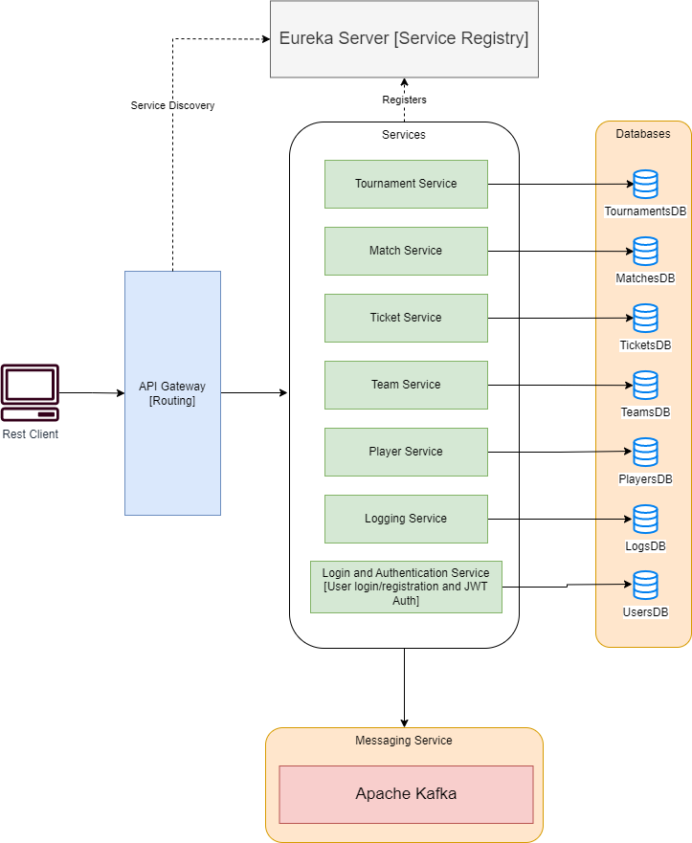
Application Architecture

Slide 5

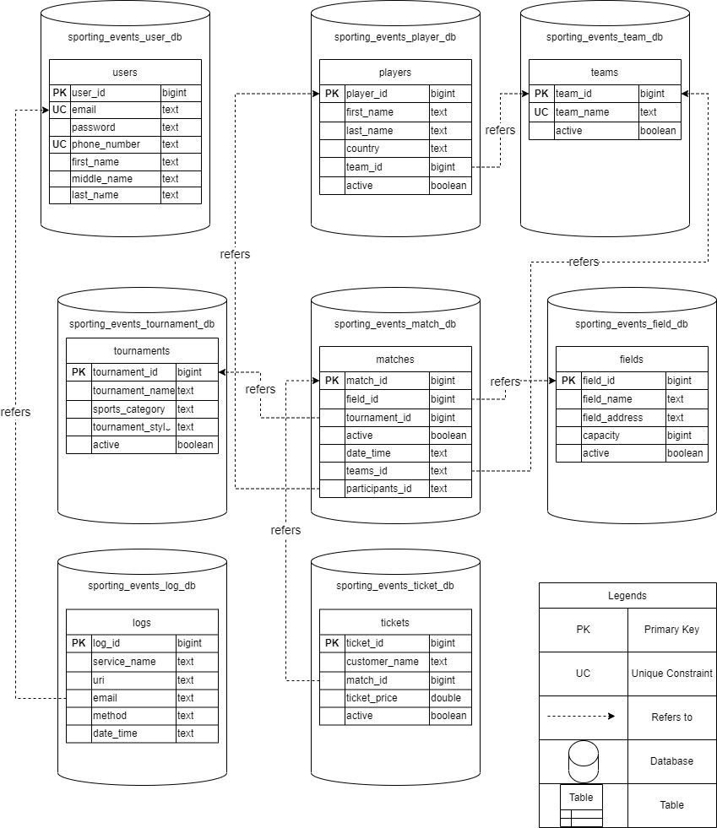

Database Design
www.collaberadigital.com

Slide 6
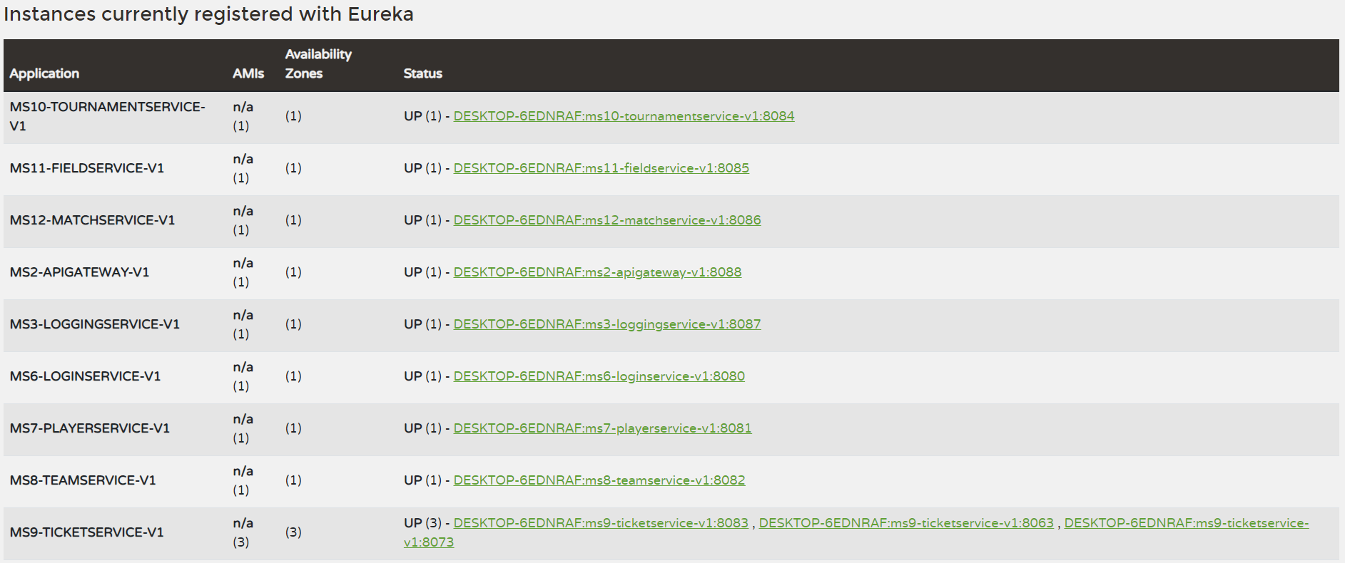
Project – Eureka Dashboard
The API gateway and multiple instances of the microservices registered on Eureka Server.
www.collaberadigital.com

Slide 7
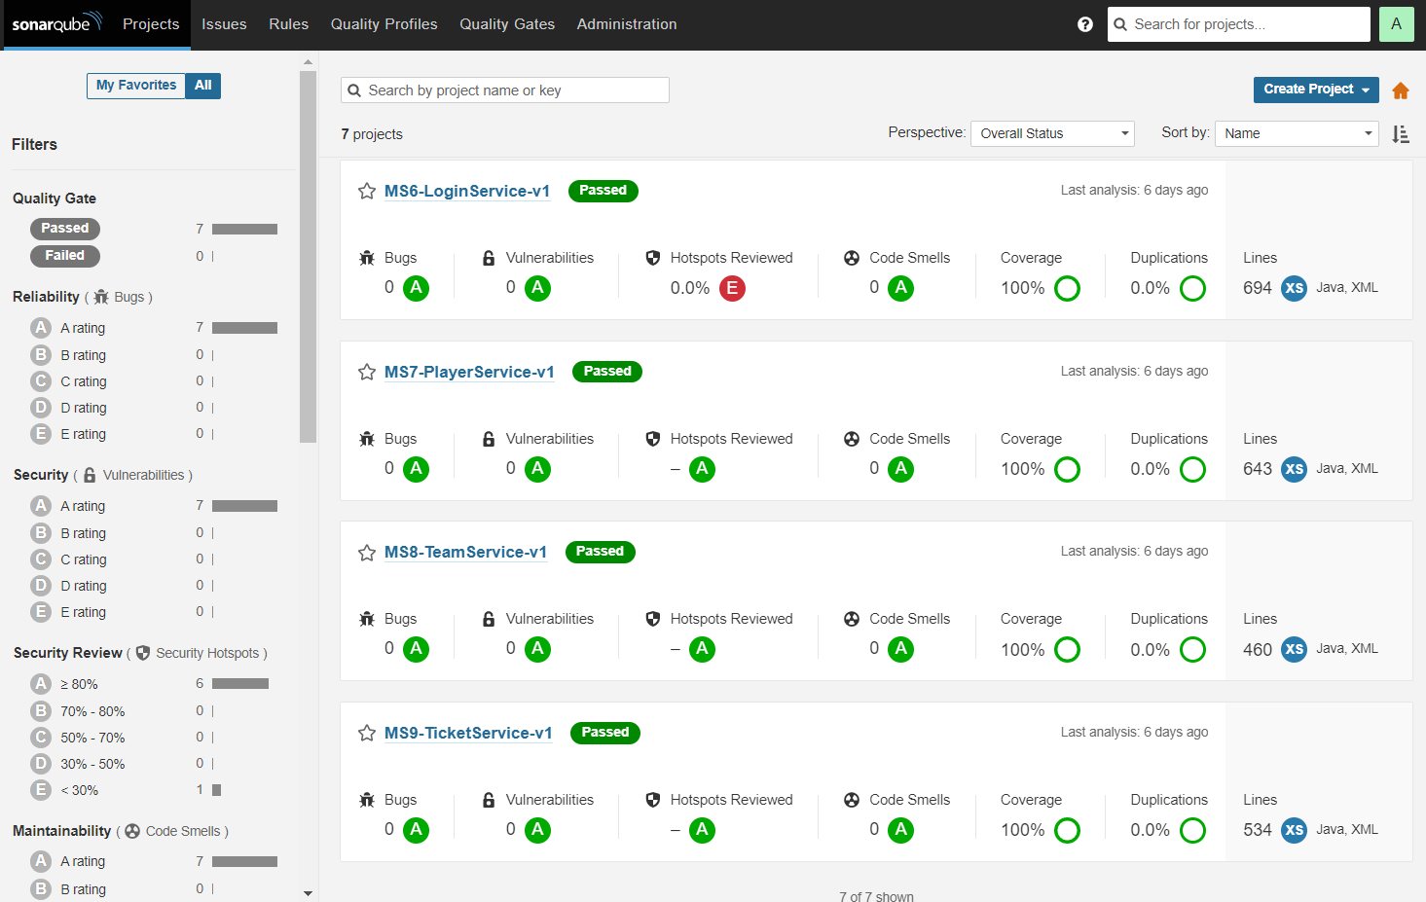
Project – SonarQube Dashboard
www.collaberadigital.com

Slide 8
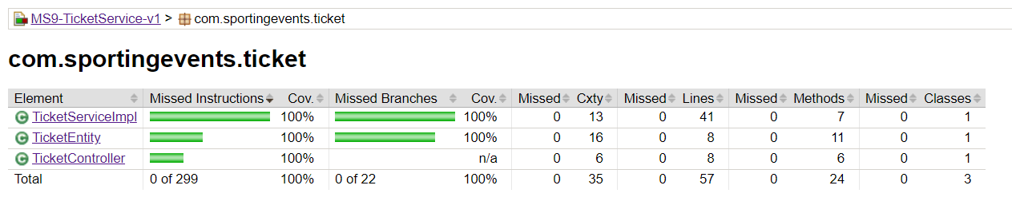
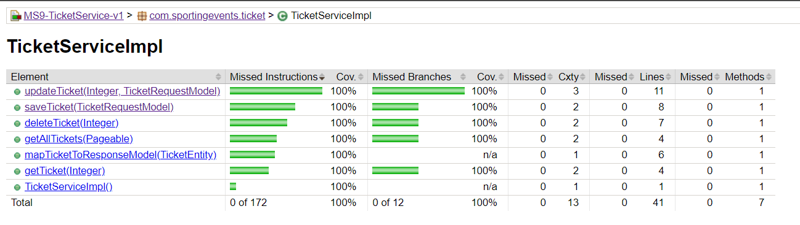
Project – Code coverage Report
www.collaberadigital.com

Slide 9
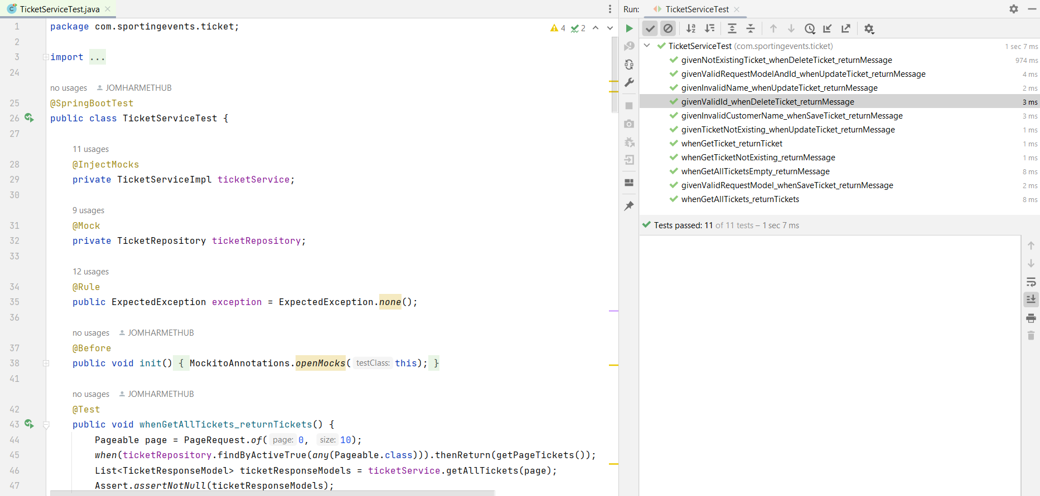
Project – Testing
Testing performed with Junit & Mockito
www.collaberadigital.com

Slide 10
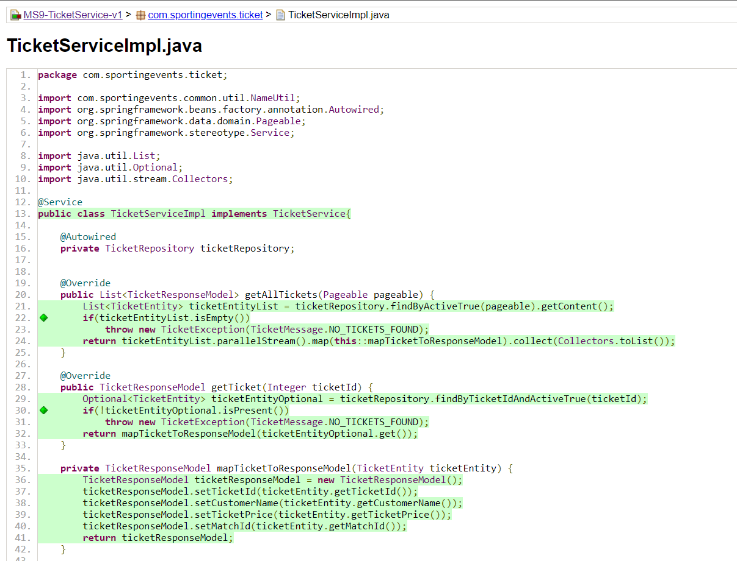
Project – Code coverage Report
www.collaberadigital.com

Slide 11
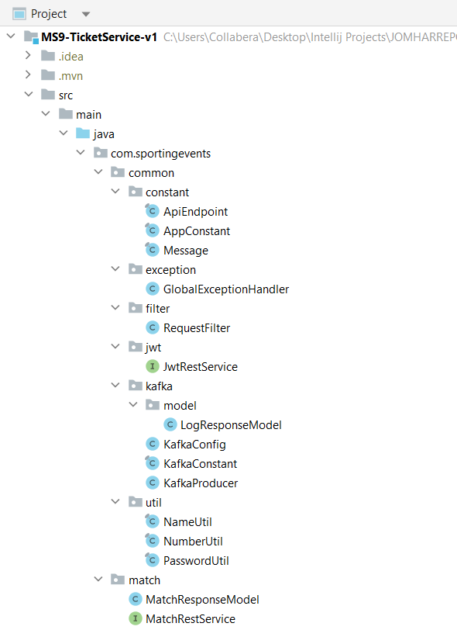
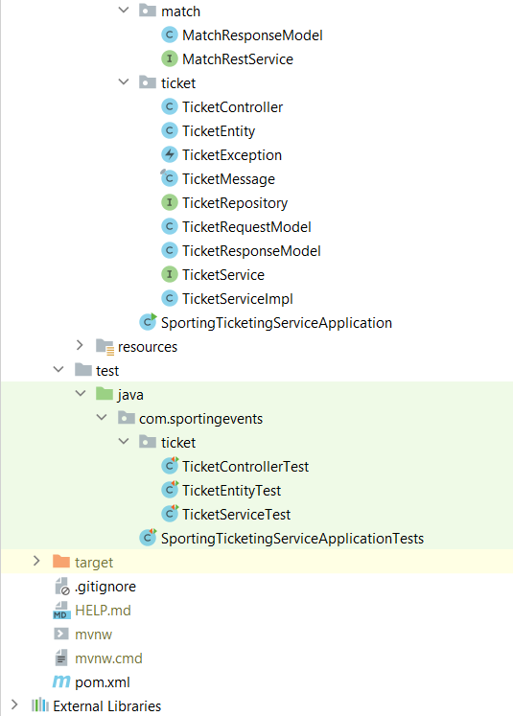
Project – Structure
www.collaberadigital.com

Slide 12
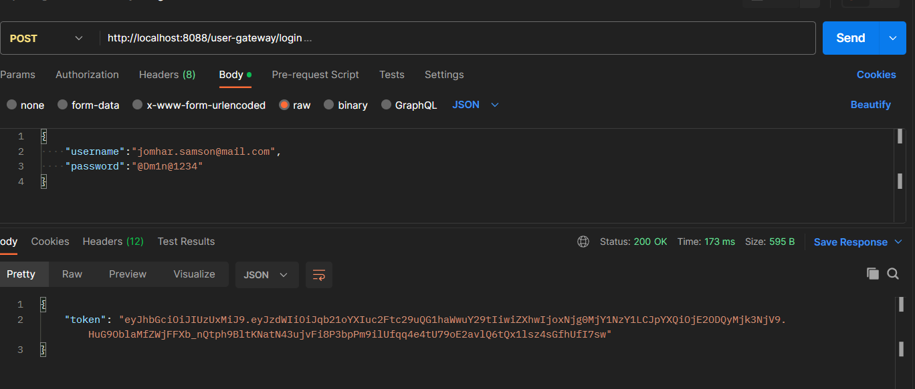
Project – Postman Authentication Jwt
www.collaberadigital.com

Slide 13
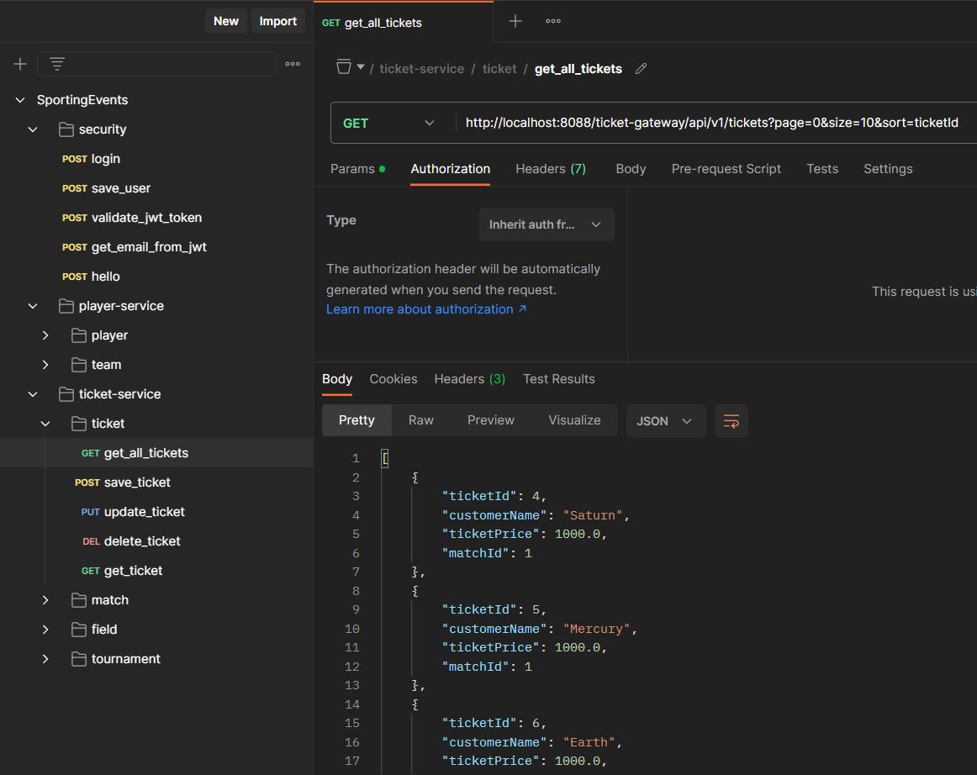
Project – Postman Ticketing Service
www.collaberadigital.com

Slide 14
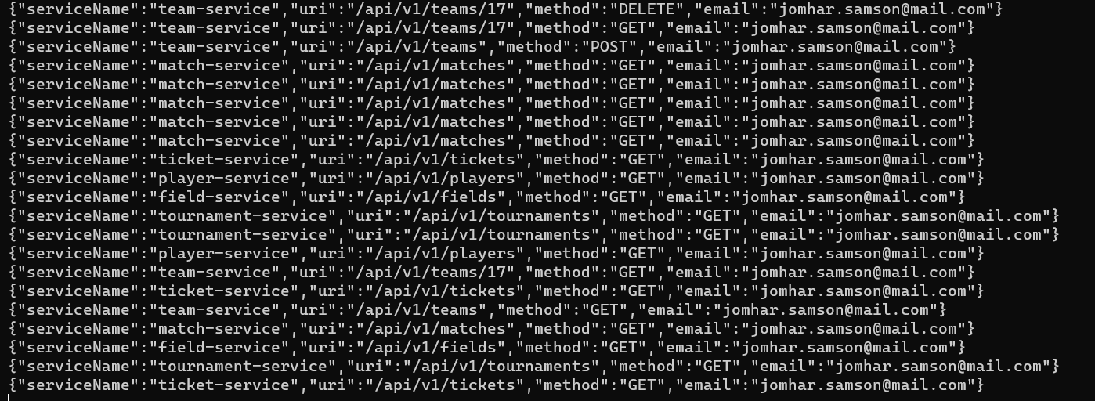
Project – Messaging with Kafka
www.collaberadigital.com

Slide 15
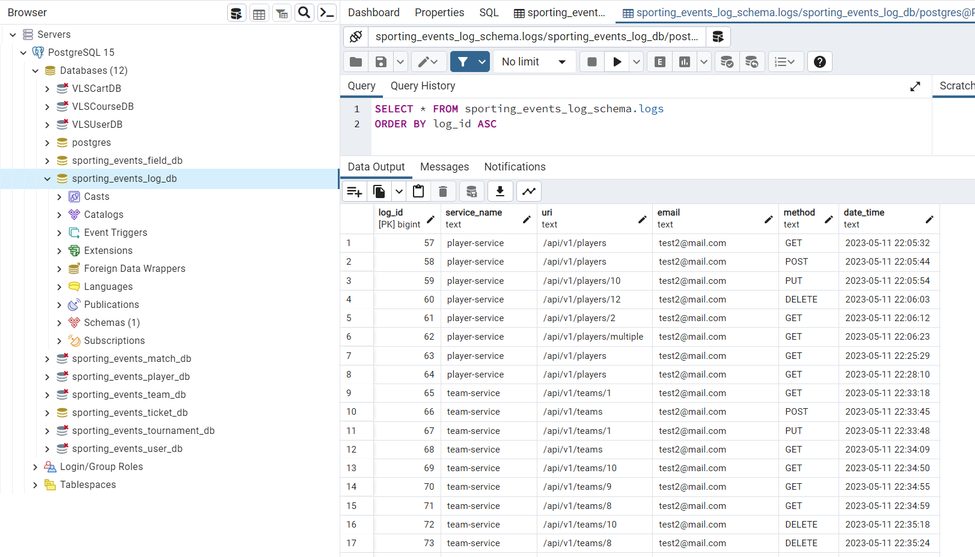
Project – Kafka message Database Logs
www.collaberadigital.com

Slide 16
Program Learning Approach
Practical Hands-on Learning Approach
Gathered requirements from User Stories
Designed microservices based on capstone requirement.
Unit tested code in parallel with development.
Refactored code and retested it after implementing feedback from the trainer
Discussed bugs, fixes and best practices with peer learners using zoom breakout rooms.
Applied various design patterns to effectively implement the capstone project.
Took up weekly quizzes and mid term test for evaluating the learning progress.

Slide 17
Key Takeaways/Learnings from the Program (HTD)
Creating Microservice applications using Spring Boot and Spring Cloud modules.
Perform Unit testing on micro services with code coverage.
Writing clean code, following best coding practices, rectifying code smells using SonarLint and working with SonarQube.
Planning, designing, coding and testing and debugging java applications.
Perform database related operations using JDBC and Hibernate ORM.
Handle exceptions across all layers of the application
Testing REST API end points with Postman
Practical knowledge of using the various spring cloud modules, namely Eureka Server, API Gateway, FeignCleint.
Implementing security using Spring Security Module and JWT Token based authentication.
Managing source code using Git Repository and hosting on GitHub.
Managing project dependencies with Maven
Working independently and as a team.

Slide 18
Conclusion
A highly practical approach to learning microservices aligned with the real-time project practices has enabled me gain confidence for building enterprise applications using the microservices architecture with best practices.
The hands-on project is built as a Microservices architecture with a token-based authentication service that secures services.
The microservices have a one database per service rule and they are all loosely coupled.
High availability is implemented using multiple instances of the same microservice application and client side load balancing is performed.
An API gateway is registered in the Eureka server to handle API requests to various endpoints.
FeignClient is used to communicate between microservices.
The project is also code smell free with the use of SonarQube.
100% code coverage is ensured in Entity, Service, and Controller Classes with Junit testing and Mockito..
Apache Kafka is implemented for real-time messaging in the microservices architecture.
The user access of various microservices are tracked and logged using a microservies using Apache Kaka.

Slide 19
Thank You
www.collaberadigital.com

